Slide 1
PROJECT TITLE: Secure data hiding in images using steganography
CAPSTONE PROJECT
Presented By: Sreepada Mohana Krishna
Student Name: Sreepada Mohana Krishna
College Name & Department: Prasad V. Potluri Siddhartha Institute Of Technology & Information Technology

Slide 2
OUTLINE
Problem Statement
Technology used
Wow factor
End users
Result
Conclusion
Git-hub Link
Future scope

Slide 3
Problem Statement
Secure communication is essential, but traditional methods are vulnerable to interception. Current solutions often lack simplicity and discretion in hiding sensitive information. There is a need for an efficient way to embed secret messages within images to ensure privacy.

Slide 4
Technology used
Python → The core language used to implement steganography and the GUI.
PyQt5: A set of Python bindings for Qt, used to build the graphical user interface (GUI).
OpenCV: A library used for image processing, enabling the encoding and decoding of messages within image pixels.
qdarkstyle: A styling library to apply a dark theme to the PyQt5 interface.
Pillow (PIL):For additional image handling capabilities
Platform: Python IDLE

Slide 5
Wow factors
Password Protection → Encrypt/Decrypt messages with a password
Drag-and-Drop Support → Users can drop images directly into the GUI.
Adjustable Opacity → Add a slider to adjust window transparency.
Real-Time Progress Bar → Show progress while encoding/decoding.
Cross-Platform Support → PNG, JPG, JPEG, GIF, BMP formats.
Modern UI with qdarkstyle → Apply professional dark mode styling.
Smooth Animations & Button Effects → Animated transitions & hover effects.
Password Toggle → Show/hide password entry option.
AES Encryption for Extra Security → Encrypt messages before hiding them.

Slide 6
End users
Cybersecurity Enthusiasts & Ethical Hackers – Secure communication & penetration testing.
Privacy-Focused Individuals – Hide sensitive data securely.
Students & Researchers – Learn steganography & cryptography.
Journalists & Whistleblowers – Covert communication in high-risk environments.
Law Enforcement & Intelligence Agencies – Secure intelligence sharing.
General Users & Developers – Explore steganography for fun or customization.

Slide 7
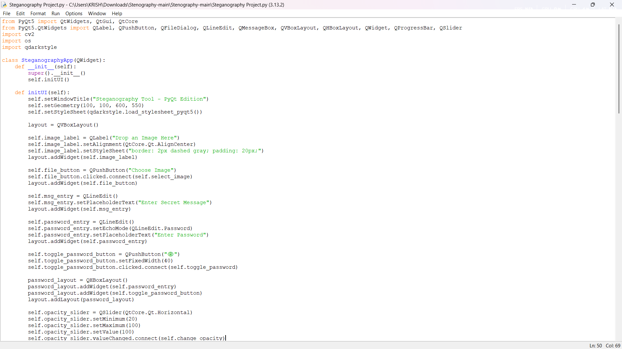
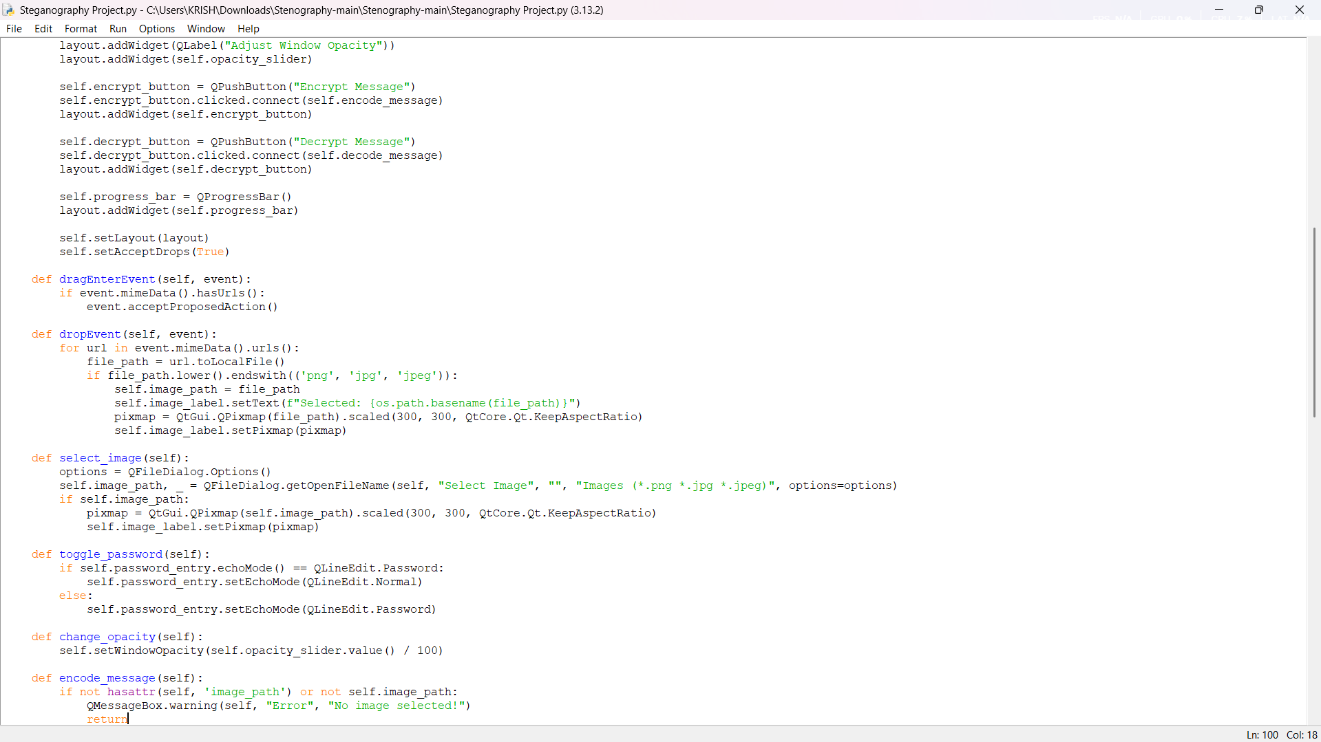
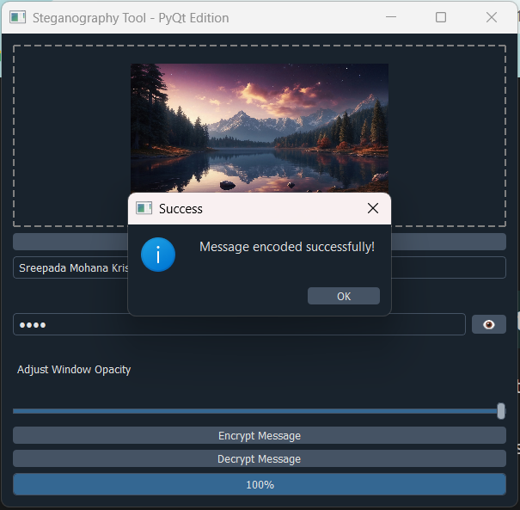
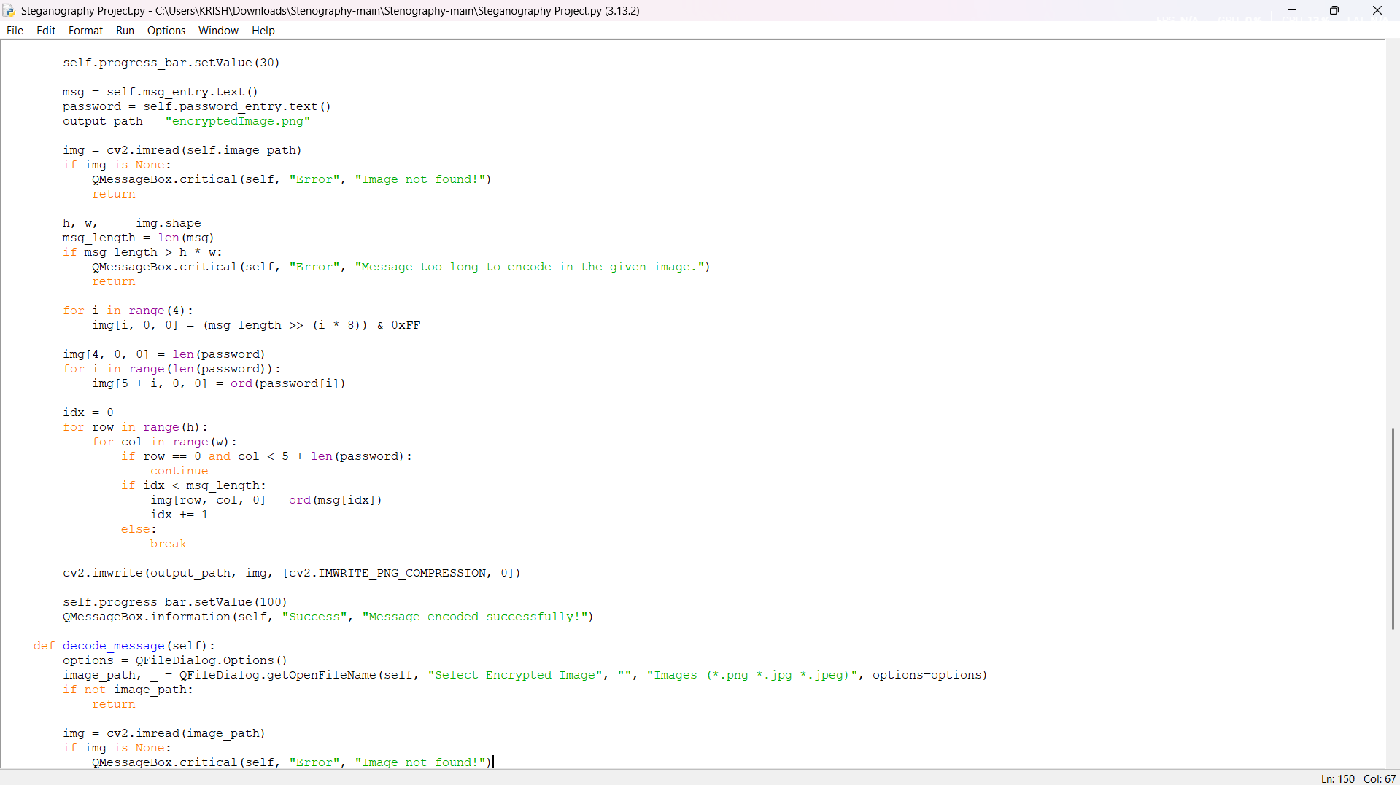
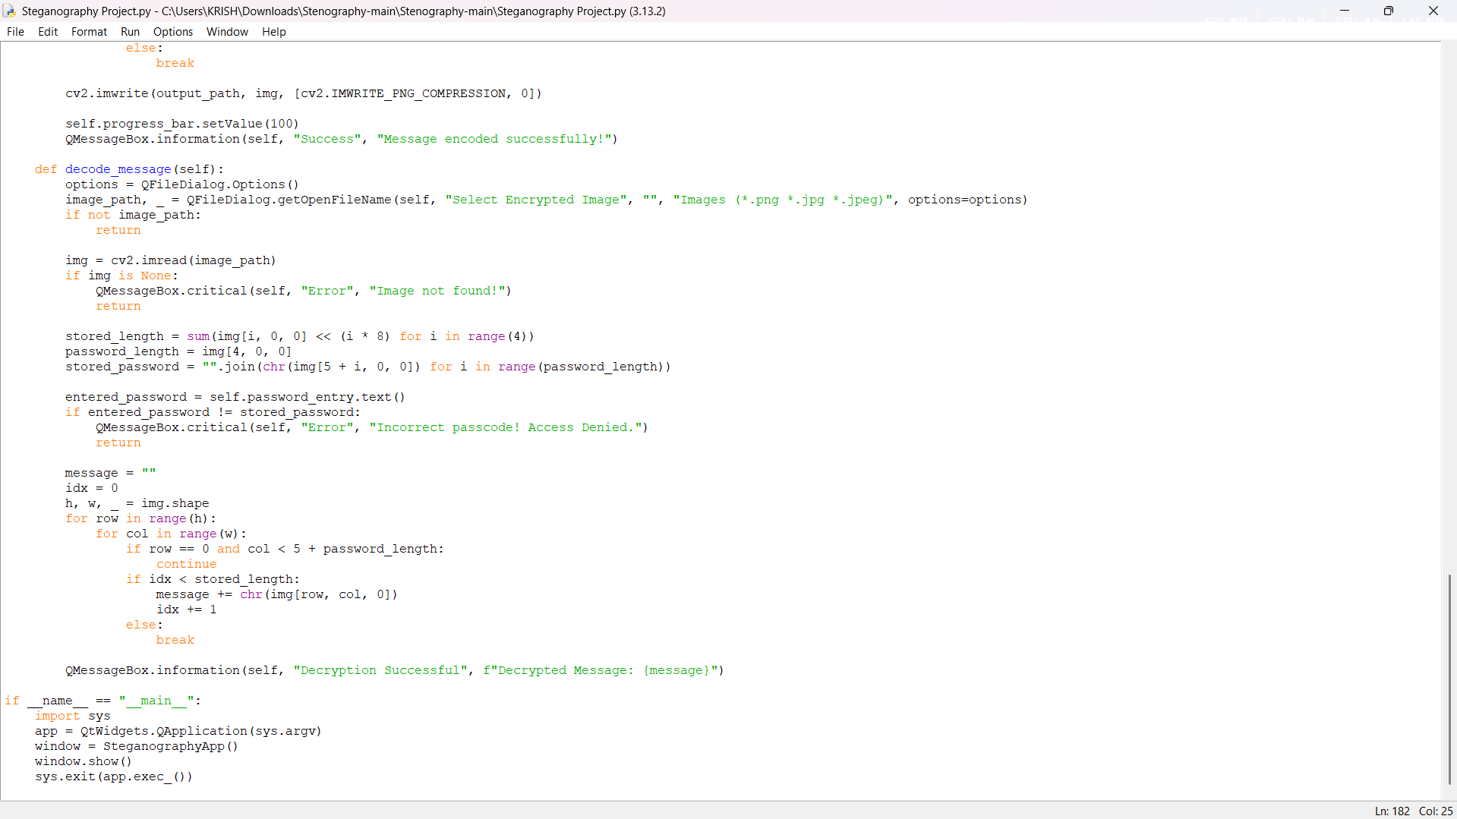
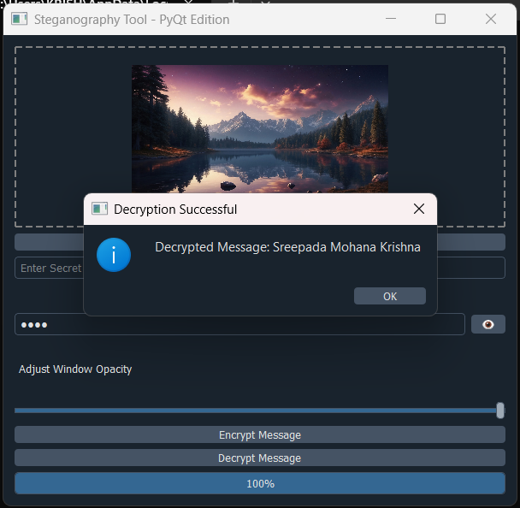
Results
1
2
Encryption Output
3
4
Decryption Output

Slide 8
Conclusion
In conclusion, this project successfully addresses the challenge of secure communication by leveraging steganography to embed confidential messages within images. By incorporating password protection and user-friendly features, it ensures data privacy and integrity, offering an efficient and discreet solution for individuals and organizations seeking to protect sensitive information.

Slide 9
GitHub Link
https://github.com/KrishRio21/AICTE--Project.git

Slide 10
Future scope(optional)
I aspire to build a dynamic career in cybersecurity at IBM, leveraging cutting-edge technologies like AI-driven security, threat intelligence, and cloud security. My focus will be on penetration testing, ethical hacking, and enterprise risk management, contributing to IBM’s mission of fortifying global cybersecurity. Through innovation and expertise, I aim to enhance digital resilience and shape a secure future.

Slide 11
THANK YOU

